Slide 1
NGO women and child welfare
Guide Name
Shweta sabnis

Slide 2
agenda
Introduction
Objective
Key features
Literature survey
1. Existing system
2. Proposed system
Tools and technologies
conclusion
references

Slide 3
introduction
Before starting any introduction first, we need to know what is NGO, NGO is a non-government organization which works for the betterment and upliftment of the social, economically and politically weaker sections of community to bring then in the main stream of society towards more improved and developed way of living and existence. it synchronizes the working of NGO. it performs different tasks for solving problems and development of society.

Slide 4
OBJECTIVE
This website or web application which will cover all the information related education, skills training, support services, and advocacy to women and girls. NGO activities include providing scholarships to girls, supporting schools that cater to girls, providing skills training to women and girls, providing support services to women and girls who have been victims of violence, advocating for the rights of women and girls, and partnering with other organizations to achieve its goals. different projects they worked ongoing projects, donor details and different activities/events and Photogallary of NGO activities.

Slide 5
Key features
Collecting the donation information: built-in donation forms are proven to drive more donations than externally linking forms - payment integration for collecting donations online.
Interactive member map: an interactive map is a great engagement tool. sort and categorize members into a member directory and map so that members can easily search for others to connect with. make sure it’s mobile-friendly, too, so that users can access it whenever they need it!
An events page : by making an easily-accessible events page, members and donors will know exactly how they can stay involved with your NGO
An updated blog: a blog is a great way to accomplish NGO activities. - it provides you with an outlet to share educational content and powerful stories that evoke emotion in readers. - determine what goal you’d like your blog to accomplish. then, develop content that communicates your vision and will push you along that path.
Social sharing options: your online engagement strategy may start with your NGO website, but it certainly doesn’t end there. in order to fully extend your reach, you need to expand your efforts to social media by featuring social sharing buttons on your website.

Slide 6
Literature survey
existing system:
Existing system is offline mode, where all works done are hidden from the people.
Without an online platform, NGO may struggle to effectively communicate with potential donors, volunteers, and beneficiaries.
If website is not available, it limits the visibility of the NGO and its activities, making it harder to reach people.
Maintaining paper reports in hard copy is crucial. potential challenges in ensuring the security of sensitive information without online security measures.

Slide 7
Proposed system:
The objective of the proposed system is to provide time efficient, user friendly, reliable, error free and maintenance free system.
This website or web application which will cover all the information of our NGO activities such as legal awareness, health camps, environment, human rights, schools, consumer protection.
By establishing website, the NGO can reach a global audience, increasing awareness and potentially attracting support from diverse geographical locations.
The website enables continuous availability of information, providing stakeholders with around-the-clock access to updates, events, and resources, enhancing communication and transparency.
Real-time updates: the website allows for instant dissemination of news and updates, keeping supporters informed about the NGO'S activities, achievements, and ongoing projects in real time.

Slide 8
Tools and technologies
Hardware requirement’s
Operating System: windows 11
Processor: 12th gen intel(r) core(tm) i5-1235u 1.30 ghz
Ram: 1gb & above
Hard Disk : atleast 1gb
SOFTWARE REQURIMENT’S
Programming Languages: java, JavaScript
Database: MySQL
Frontend: HTML, CSS, bootstrap
Backend: PHP, JavaScript

Slide 9
conclusion
The NGO women and child welfare project focuses on empowering and supporting vulnerable women and children through various initiatives, including education, healthcare and skill development. the goal is to enhance their overall well-being and create a positive impact on their lives.

Slide 10
reference
rajshekar durgam(2020) , "references", managing NGO's in rule development 19(2): 249-24
website reference model:
https://morweb.org/post/ngo websites

Slide 11
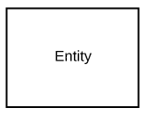
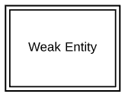
ER diagram
Definition: An er diagram models the relationships between entities in a database. it
illustrates how different entities are related to each other and helps in designing a relational
database schema.
Symbols:
ENTITY
WEAENTK ITY

Slide 12
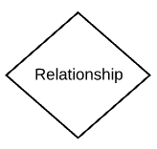
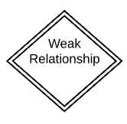
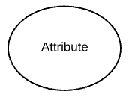
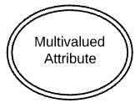
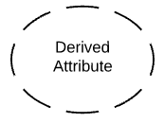
RELATIONSHIP
WEAK RELATIONSHIP
ATTRIBUTE
MULTIVALUED ATTRIBUTE
DERIVED ATTRIBUTE

Slide 13
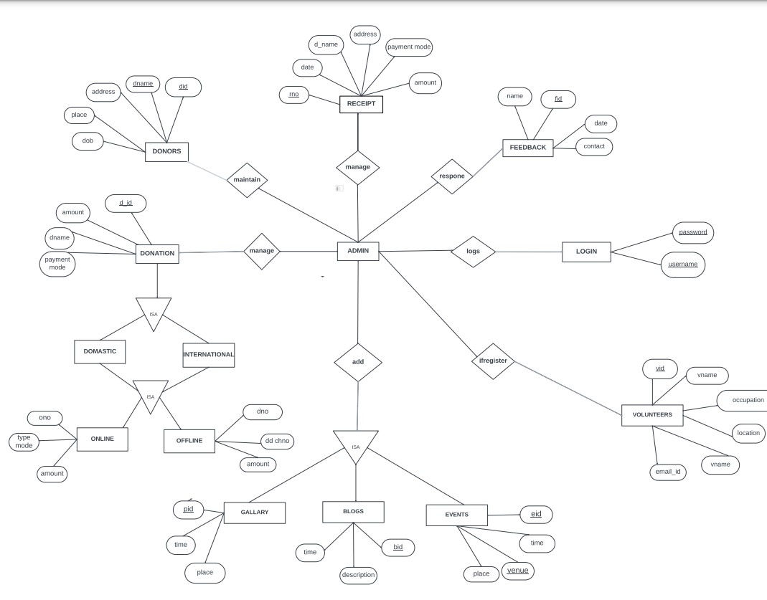

Slide 14
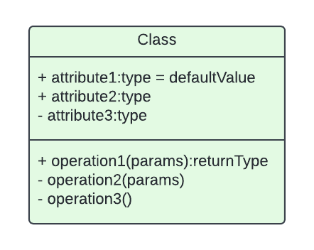

Class diagram
Definition : A class diagram illustrates the structure of a system by showing the classes,
attributes, operations, and the relationships between them.
Symbols:
name
attributes
Realation relation
association

Slide 15


directed Association
-------------------
| <<interface>> |
| Interface |
------------------- INTERFACE
| method1() |
| method2() |
-------------------

Slide 16
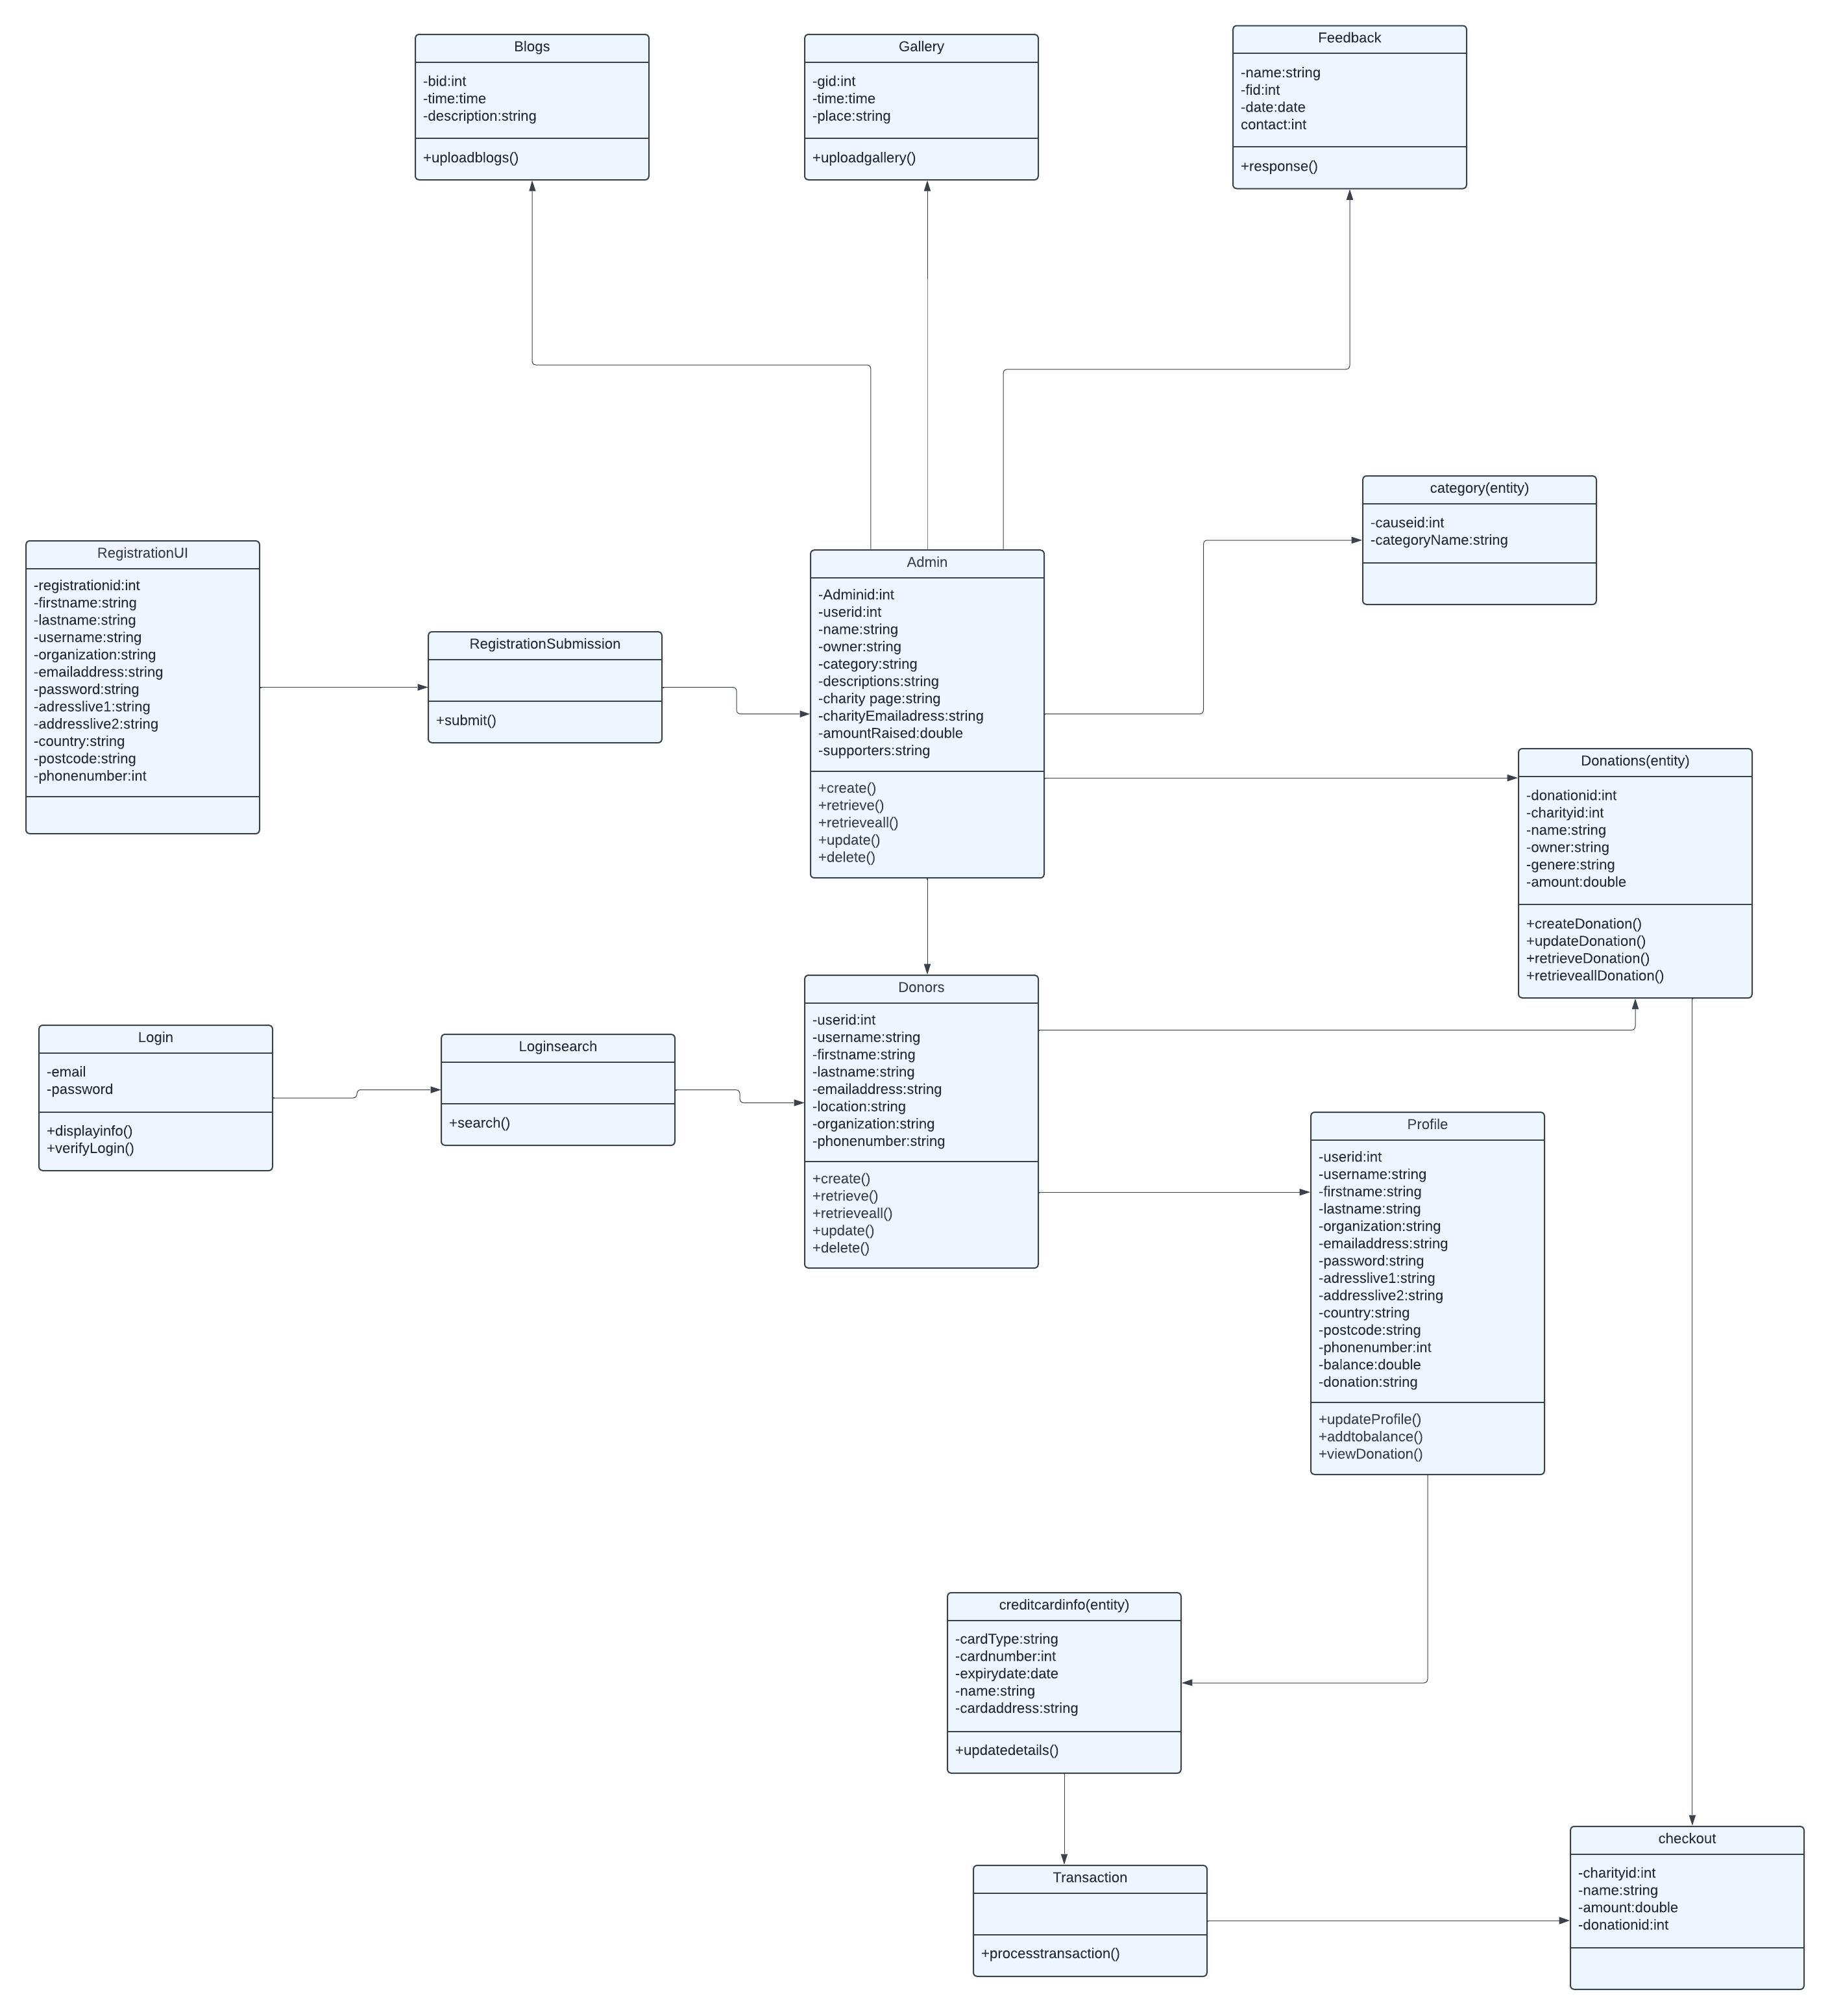

Slide 17



Sequence diagram
Definition: A sequence diagram visualizes the interactions between objects in a system over
time. it shows the sequence of messages exchanged between objects to achieve a specific
Functionality.
Symbols:
OBJECT FLO OBJECT FLOW
OBJECT ATTRIBUTES
SYNCHRONOUS MESSAGE

Slide 18

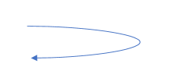


ASYNCHRONUS MESSAGE
SELF MESSAGE
BARS
STATE

Slide 19
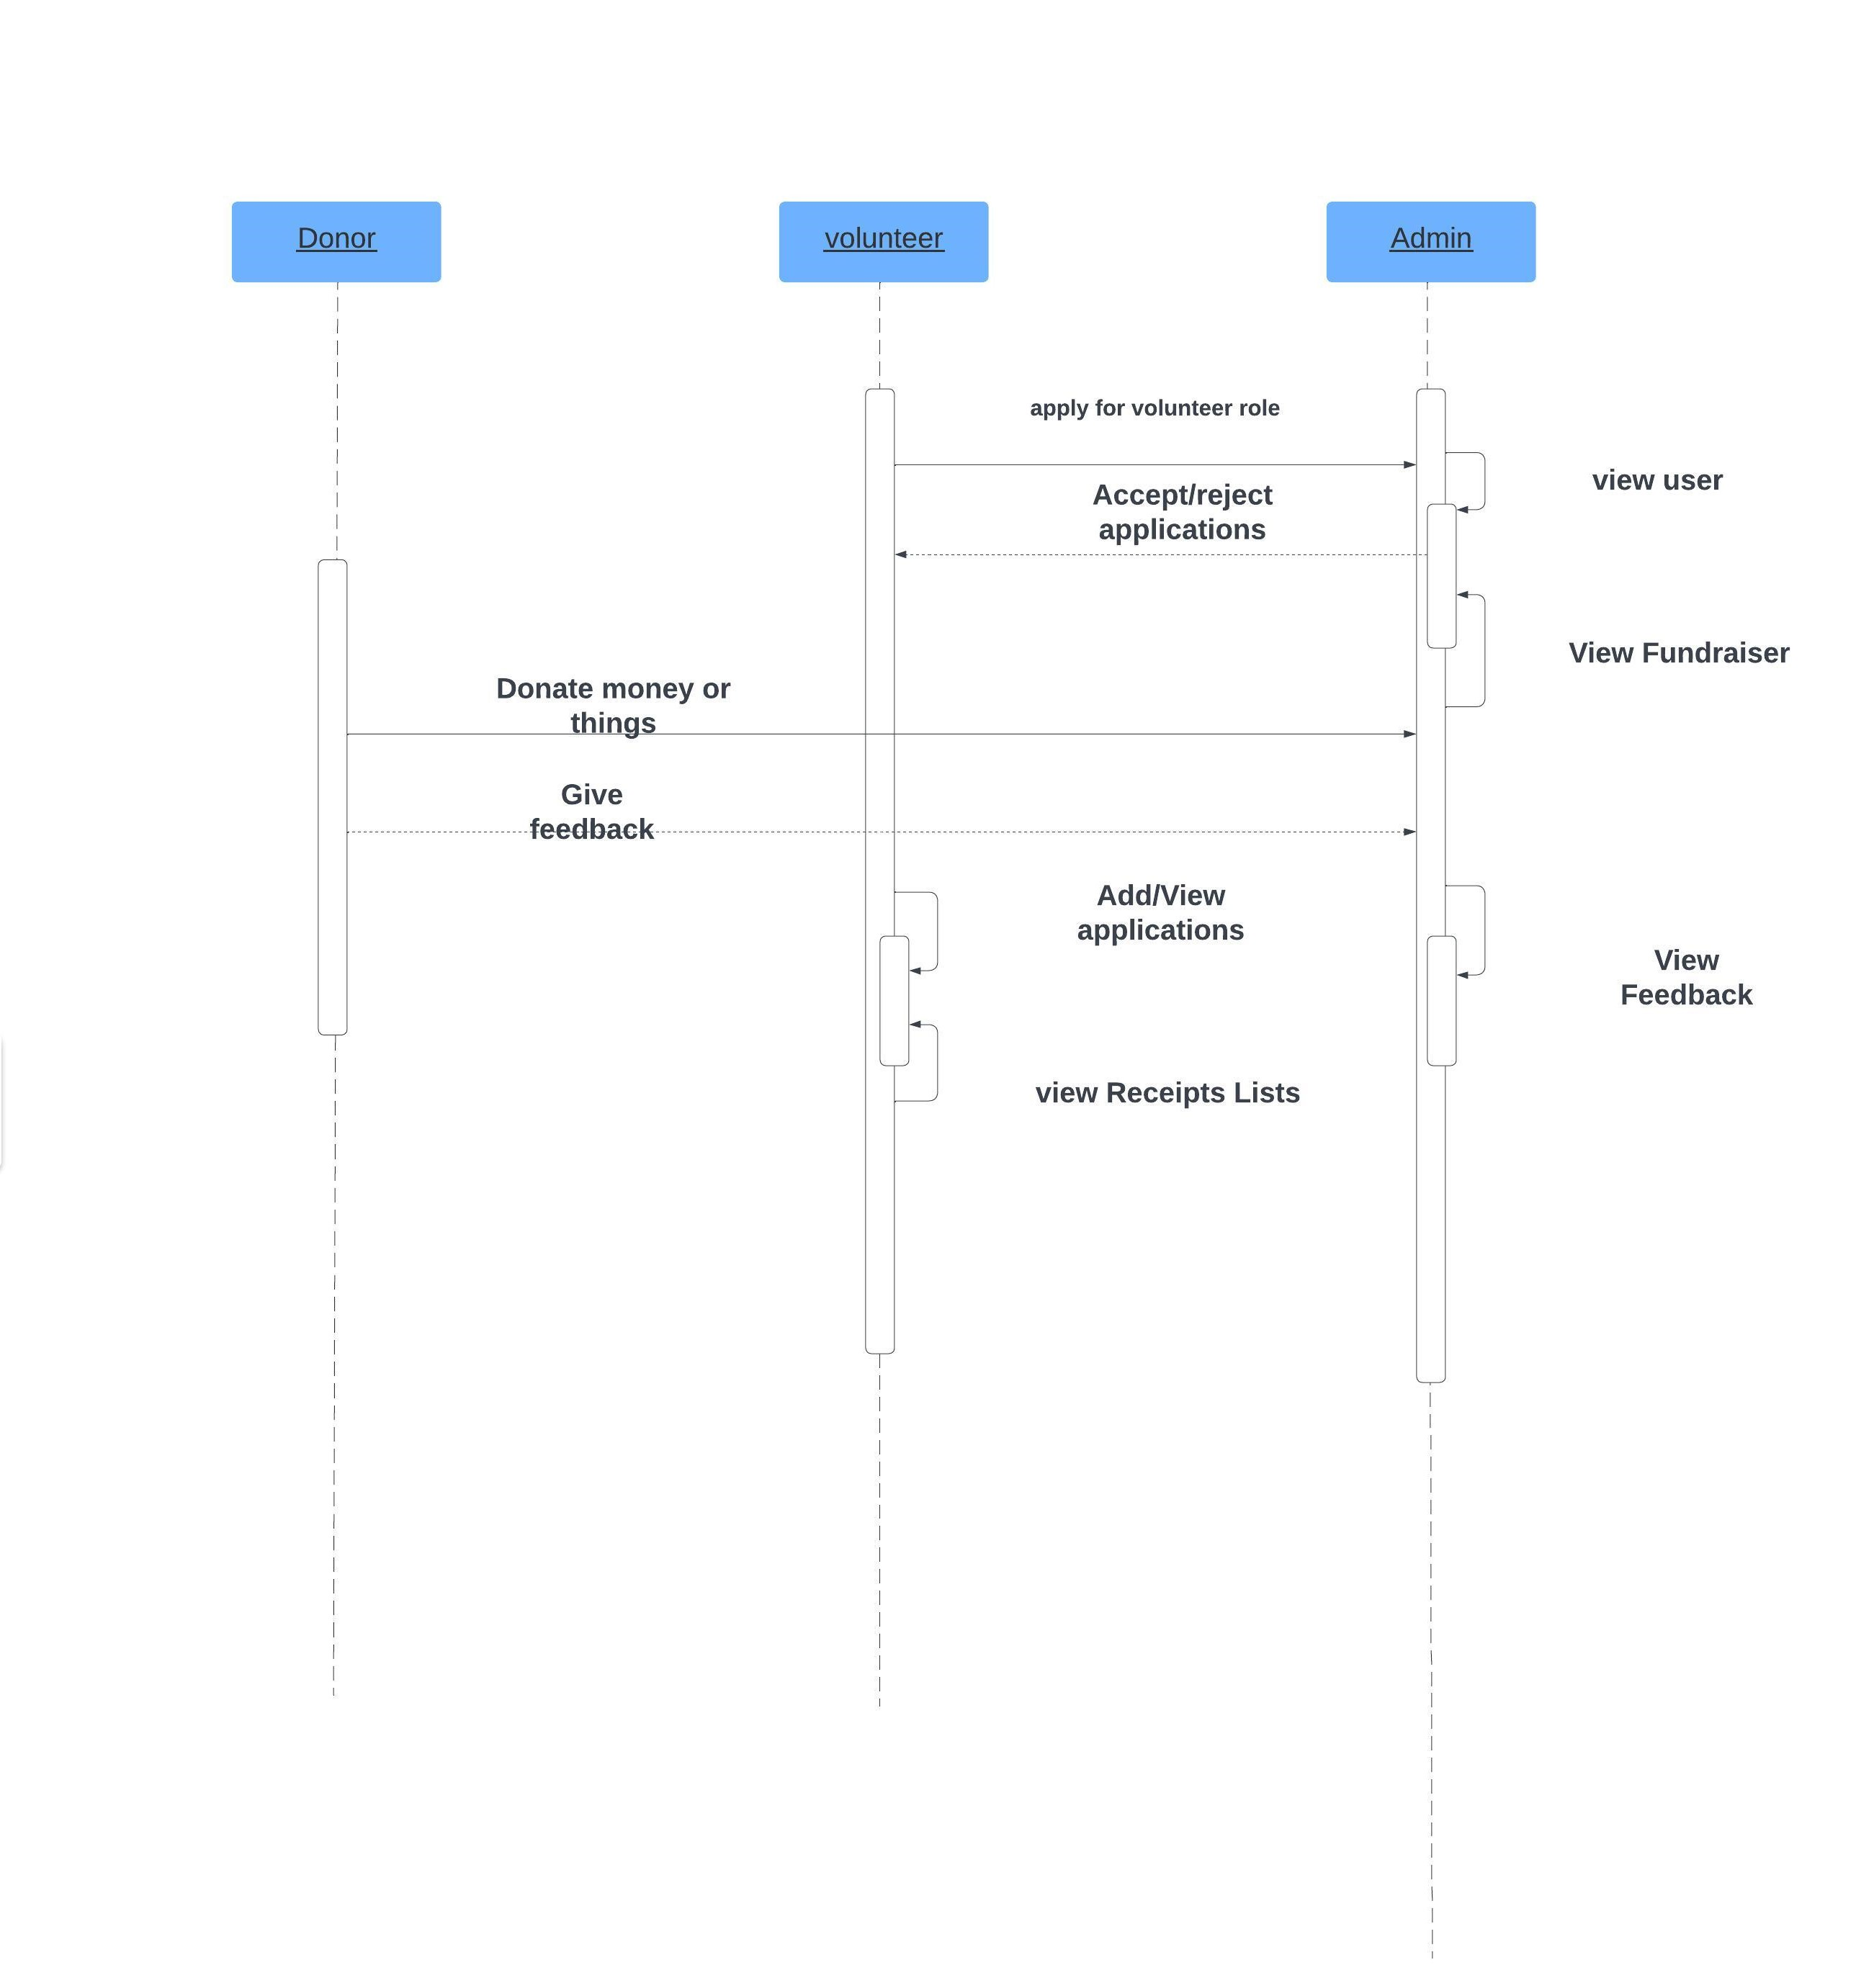

Slide 20
Thank you

